Slide 1
Research Skills
Week 9: Regression.

Slide 2
Last week
Looked at data from maths questionnaire.
Hypotheses.
Chi-Square problem sheet.

Slide 3
Today
Lab report reminders.
Regression problem sheet.

Slide 4
Section | Max. marks | Content
Title | 2 | IV and DV (precise and no more than 15 words)
Abstract | 12 | Maximum 150 words, summary of all sections
Introduction | 20 | Past research; rationale; hypotheses
Methods | 20 | Participants; materials; design; procedure – in enough detail for someone else to replicate the study
Results | 20 | Clear and logical descriptive and inferential stats; well designed figures related to the findings
Discussion | 20 | Summary of main results, relating to introduction; evaluation of study, suggestions for future
References | 6 | Full APA-style references for all citations in main text
Appendices | 0 | Questionnaire, by-hand workings out…
Word limit: 2000
(not including title, abstract, or references)

Slide 5
Title
Straightforward and informative (not more than 15 words)
Enough to explain your study without going into too much detail
Examples:
Too little detail: Fast food purchases
Too much detail: Differences in the fast food purchasing habits of men and women in the last month in Brighton
Just right: Differences in the fast food purchasing habits of men and women
2 marks: identifies the IV and DV, not too vague or too long, encapsulates the purpose of the report well.

Slide 6
Abstract
Must have:
Explanation of research area
Aims
Main results and interpretations
Implications of your results for science and/or society
100-150 words
8+ marks: clear and succinct (150 words at most) summary of the aims, methods, results and conclusions of the study. Includes all the necessary information, and is well written.

Slide 7
Introduction
Quick explanation of research area
Summary of relevant past research (and perhaps its flaws)
Purpose of study
Brief description of methods
Hypothesis
650-700 words
15+ marks: clearly written, well structured, with evidence of relevant extra reading, flows well. Identifies the main aims, and ends with a clear outline of the study's hypotheses. Also has something novel in it, compared to the handouts that were supplied, and includes the rationale for performing the study.

Slide 8
Method
Give enough information so that it is obvious what you did
Subsections:
Participants
Materials
Design
Procedure
Write in paragraphs (no lists!)

Slide 9
Participants
Number of participants
Sex (# of men, # of women)
Who (students, women, the retired, etc)
Volunteers or paid?
Any other demographics that might be necessary

Slide 10
Materials
Things you used:
Questionnaire (do not include the whole thing!)
Any other materials you think are necessary to include
DON’T INCLUDE: Pen, A4 paper, etc.

Slide 11
Design
Identify:
Independent variable(s)
Dependent variable(s)
Design: within-subjects, between-subjects or mixed?
Don’t worry about this section this term
Just say you used a questionnaire design

Slide 12
Procedure
Explain how the experiment was carried out
Step by step breakdown of what was done
Informed consent

Slide 13
Results
Inferential statistics (Chi-Square test; regression; correlation).
Figure (Chi-square – frequency; regression/correlation – scatter plot).
N.B. if it’s a bar chart report the Frequencies/means & SEs in text.

Slide 14
Frequency graph
Figure 1: the frequency of monster attacks by Aliens and Predators in America, Britain and China.

Slide 15
Scatter plot
Notes:
.

Slide 16
Discussion
Summary of purpose and results
Comparison to previous research
Possible faults
Wider implications (back up your assertions)
Future directions
Conclusions
500-550 words
15+ marks: clear summary of main results, followed by a successful attempt to relate the findings to relevant previous theoretical and empirical research. Intelligent evaluation of the strengths, weaknesses and limitations of the study that was performed, and sensible suggestions for possible improvements and extensions to it. Well organised and clearly written.

Slide 17
Other things:
APA formatting (references)
Purple prose
Orwell’s 6 rules

Slide 18
Regression problem sheet

Slide 19
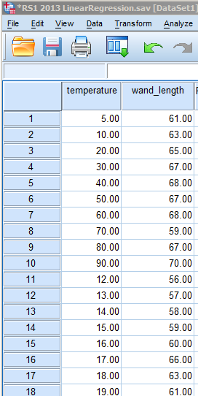
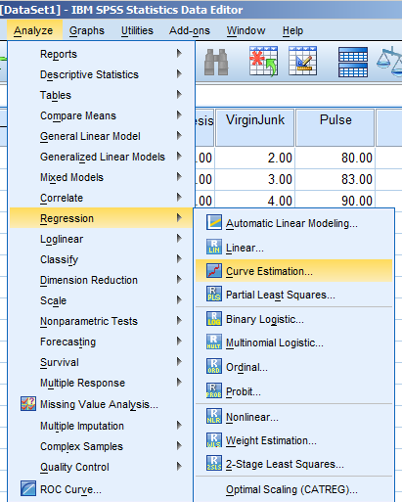
Temperature and the length of Sooty’s magic wand

Slide 20
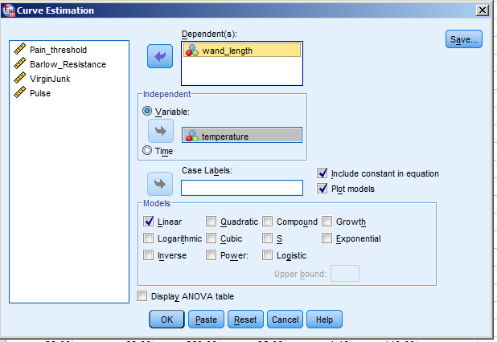
Predicted variable goes in here
Predictor variable goes in here

Slide 21
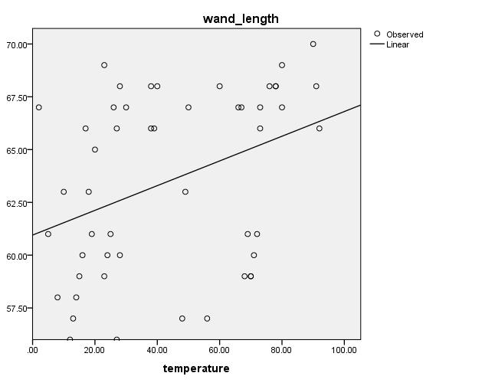
Normally, redo graphs in Excel – but for this scatterplot, edit it within SPSS (by double-clicking on the graph).

